Slide 1

Chapter 7
Costs and Cost Minimization

Slide 2
Chapter Seven Overview
1. What are Costs?
2. Long Run Cost Minimization
The constraint minimization problem
Comparative statics
Input demands
Short Run Cost Minimization
Chapter Seven

Slide 3
Explicit Costs and Implicit Costs
Explicit Costs – Costs that involve a direct monetary outlay.
Implicit Costs – Costs that do not involve outlays of cash.
Chapter Seven

Slide 4
Opportunity Cost
The relevant concept of cost is opportunity cost: the value of a resource in its best alternative use.
The only alternative we consider is the best alternative
Chapter Seven

Slide 5
Economic Costs and Accounting Costs
Economic Costs – Sum of a firm’s explicit costs and implicit Costs.
Accounting Costs – Total of a firm’s explicit costs.
Chapter Seven

Slide 6
Sunk Costs
Sunk Costs are costs that must be incurred no matter what the decision. These costs are not part of opportunity costs.
Example: Bowling Ball Factory
It costs $5M to build and has no alternative uses
$5M is not sunk cost for the decision of whether or not to build the factory
$5M is sunk cost for the decision of whether to operate or shut down the factory
Non-Sunk Costs are costs that must be incurred only if a particular decision is made.
Chapter Seven

Slide 7
Cost Minimization
Cost minimization problem: Finding the input combination that minimizes a firm’s total cost of producing a particular level of output.
Cost minimization firm: A firm that seeks to minimize the cost of producing a given amount of output.
Long run: A period of time when the quantities of all of the firm’s input can vary.
Short run: A period of time when at least one of its inputs’ quantities is fixed.
Chapter Seven

Slide 8
Long-Run Cost Minimization
Minimize the firm’s costs, subject to a firm producing a given amount of output.
Cost to the Firm:
TC = Total Cost
w = wage rate
L = Quantity of Labor
r = price per unit of capital services
K = Quantity of Capital
Chapter Seven

Slide 9
Isocost Line
The set of combinations of labor and capital that yield the same total cost for the firm.
Chapter Seven

Slide 10
Isocost Line
w = $10/hour
r = $20/hour
TC = $1 million
$1 mil = $10L + $20K
K = $1 mil/20-(10/20)L
Or more generally:
Chapter Seven

Slide 11
Isocost Lines
K
Direction of increase in total cost
TC₂/r
TC₁/r
TC₀/r
Combinations of labor and capital that yields the same total cost for the firm
Slope = -w/r
L
TC₀/w TC₁/w TC₂/w
Chapter Seven

Slide 12
Long-Run Cost Minimization
Suppose that a firm’s owners wish to minimize costs
Let the desired output be Q₀
Technology: Q = f(L,K)
Owner’s problem: min TC = rK + wL
K,L
Subject to Q₀ = f(L,K)
TC = rK + wL …or…
K = TC/r – (w/r)L
is the isocost line
Chapter Seven

Slide 13
Long-Run Cost Minimization
Cost minimization subject to satisfaction of the isoquant equation: Q₀ = f(L,K)
Note: analogous to expenditure minimization for the consumer
Tangency Condition:
MRTS_{L,K} = -MP_{L}/MP_{K} = -w/r (or) MP_{L}/w = MP_{K}/r
Constraint: Q₀ = f(K,L)
Chapter Seven

Slide 14
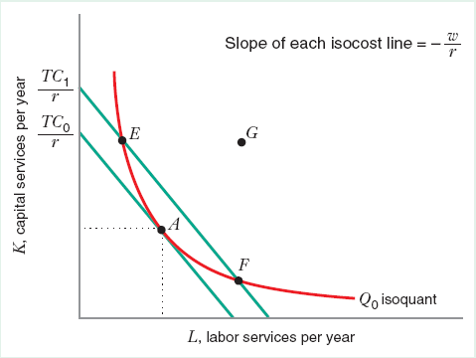
Long-Run Cost Minimization
Solution to cost minimization:
Point where isoquant is just tangent to isocost line (A)
G – Technically Inefficient
E & F – Technically Efficient but do not minimize cost
Chapter Seven

Slide 15
Long-Run Cost Minimization
Solution to cost minimization:
Slope of isoquant = slope of isocost line
(or)
Ratio of marginal products = ratio of input prices
Chapter Seven

Slide 16
Long-Run Cost Minimization
At point E
This implies the firm could spend an additional dollar on labor and save more than a dollar by reducing its employment of capital and keep output constant
Chapter Seven

Slide 17
Long-Run Cost Minimization
At point F
This implies the firm could spend an additional dollar on capital and save more than a dollar by reducing its employment of labor and keep output constant
Chapter Seven

Slide 18
Interior Solution
Q = 50L^{1/2}K^{1/2}
MP_{L} = 25L^{-1/2}K^{1/2}
MP_{K} = 25L^{1/2}K^{-1/2}
w = $5
r = $20
Q₀ = 1000
MP_{L}/MP_{K} = K/L => K/L = 5/20…or…L=4K
1000 = 50L^{1/2}K^{1/2}
K = 10; L = 40
Chapter Seven

Slide 19
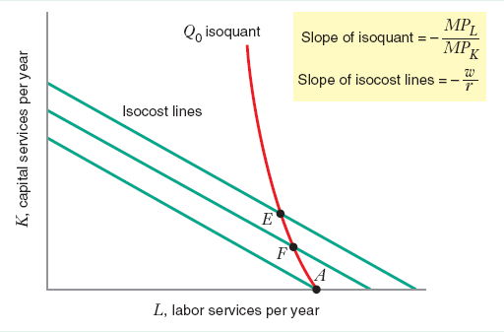
Corner Solution
The cost-minimizing input combination for producing Q₀ units of output occurs at point A where the firms uses no capital. At this corner point the isocost line is flatter than the isoquant.
Chapter Seven

Slide 20
Corner Solution (isoquants are straight lines here)
Q = 10L + 2K
MP_{L} = 10
MP_{K} = 2
w = $5
r = $2
Q₀ = 200
MP_{L}/MP_{K} = 10/2 > w/r = 5/2
But… the “bang for the buck” in labor larger than the “bang for the buck” in capital…
MP_{L}/w = 10/5 > MP_{K}/r = 2/2
K = 0; L = 20
Chapter Seven

Slide 21
Comparative Statics
A change in the relative price of inputs changes the slope of the isocost line.
All else equal, an increase in w must decrease the cost minimizing quantity of labor and increase the cost minimizing quantity of capital with diminishing MRTS_{L,K}.
All else equal, an increase in r must decrease the cost minimizing quantity of capital and increase the cost minimizing quantity of labor.
Chapter Seven

Slide 22
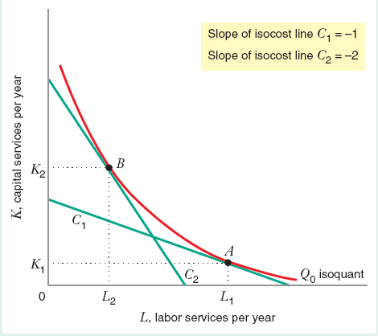
Change in Relative Prices of Inputs
Price of capital r = 1
Quantity of output Q₀ is constant.
When price of labor w = 1 the isocost line is C1, optimal point A
When price of labor w = 2 isocost line is C2, optimal point B
Note C2 > C1 !!
Chapter Seven

Slide 23
Some Key Definitions
An increase in Q₀ moves the isoquant Northeast.
Expansion Path: A line that connects the cost-minimizing input combinations as the quantity of output, Q, varies, holding input prices constant.
Normal Inputs: An input whose cost-minimizing quantity increases as the firm produces more output.
Inferior Input: An input whose cost-minimizing quantity decreases as the firm produces more output.
Chapter Seven

Slide 24
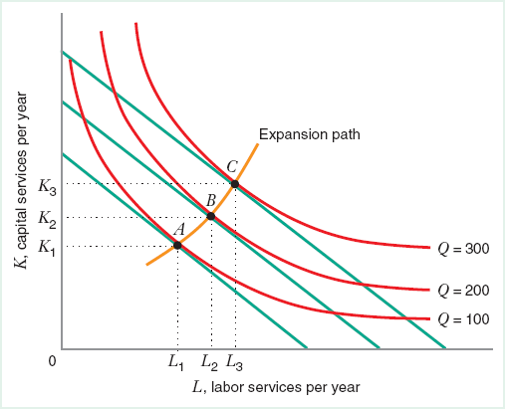
An Expansion Path
As output increases, the cost minimization path moves from point A to B to C when inputs are normal
Chapter Seven

Slide 25
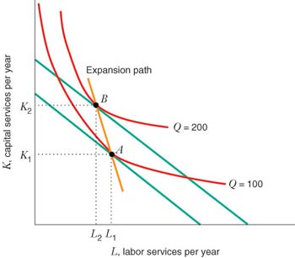
An Expansion Path (with labour inferior – weird)
As output increases, the cost minimization path moves from point A to B to C when labor is an inferior input
Chapter Seven

Slide 26
Input Demand
Definition: A function that shows how the firm’s cost-minimizing quantity of input varies with the price of that input.
Labor demand curve: Shows how the firm’s cost-minimizing quantity of labor varies with the price of labor.
Capital demand curve: Shows how the firm’s cost-minimizing quantity of capital varies with the price of capital.
Chapter Seven

Slide 27
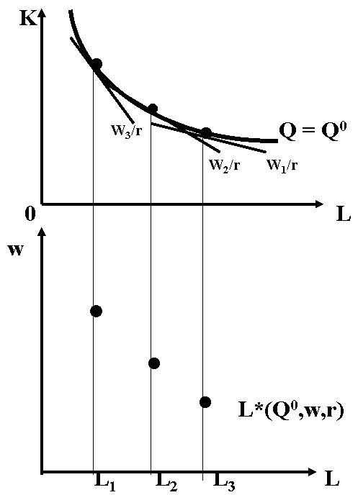
Input Demand Functions
Chapter Seven

Slide 28
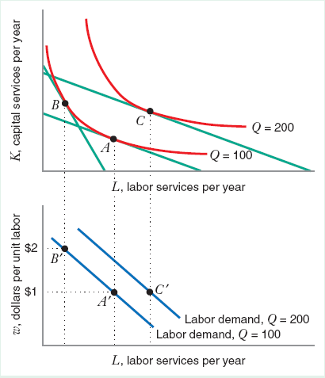
Input Demand
For a fixed quantity, as price of labor increases from $1 to $2, firm moves along its labor demand curve from A to B. Increase in output shifts the demand curve.
Chapter Seven

Slide 29
Price Elasticity of Demand for Inputs
Percentage change in the cost-minimizing quantity of labor with respect to a 1% change in the price of labor.
Percentage change in the cost-minimizing quantity of capital with respect to a 1% change in the price of capital.
Chapter Seven

Slide 30
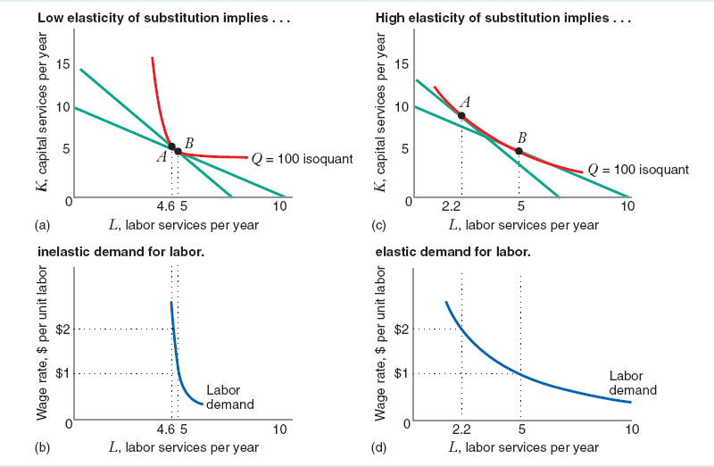
Price Elasticity of Demand for Inputs
Chapter Seven

Slide 31
Short-Run Cost Minimization
Total Variable Costs – the sum of total expenditures on variable inputs, such as labor and materials, at the short-run cost-minimizing input combination
Total Fixed Costs – the cost of fixed inputs; it does not vary with output
Variable and nonsunk
Fixed and nonsunk
Fixed and sunk
Chapter Seven

Slide 32
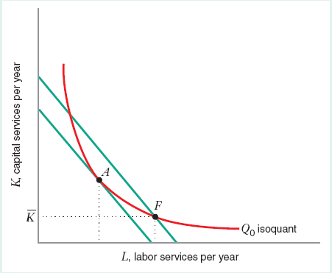
Short-Run Cost Minimization
One fixed Input - Capital
Short run combination is point F
If the firm were free to adjust all of its inputs, the cost-minimizing combination is at Point A
Chapter Seven

Slide 33
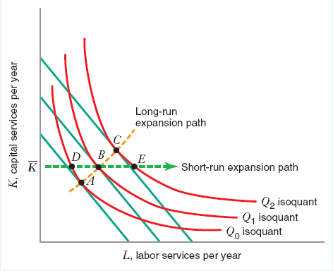
Short-Run Cost Minimization
Long run-all variables are variable and the expansion path is from A – B – C
Short run-some variables are fixed (capital)-the expansion path is from D –E –F
Chapter Seven

Slide 34
Short-Run Cost Minimization
Short run: One input is fixed, capital . Firm can vary the other input, labor. SO demand for labor will be independent of price.
Short run demand for labor will also depend on quantity produced. As quantity increased, labor used increases holding capital fixed.
Chapter Seven

Slide 35
Short-Run Cost Minimization
Capital is fixed
Chapter Seven

Slide 36
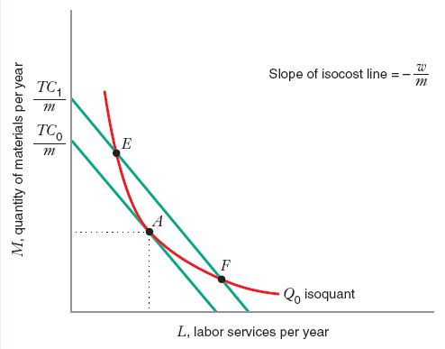
Short-Run Cost Minimization
More than one variable input – analysis similar to long-run cost minimization
3 inputs – labor (L), capital ( ), raw materials (M)
Chapter Seven

